Slide 1
Ministry of Jal Shakti
Department of Water Resources, RD & GR
Water Information Management System (WIMS)
National Water Informatics Centre

Slide 2
Online WIMS Training Session
National Water Informatics Centre(NWIC)
Topic : Data Entry, Data Validation & Data View
Date of Training: 20/05/2021
Venue: Online Webinar
Organised By : NWIC
.

Slide 3
Welcome
.

Slide 4
Water Information Management System (WIMS)
National Water Informatics Centre(NWIC)
Contact Details :
Trainer Name : Meet Kumar Agarwal
Department : National Water Informatics Centre(NWIC) Email Id :helpdesk-nwic@gov.in Contact No : 9650866776

Slide 5
About WIMS
Water Information Management System
Web Based
WIMS is a web-based open source software system for managing data entry for Surface Water and Ground Water Resources.
Scalable & Integrated
WIMS Software is an extension of eSWIS software.
Secured Data
WIMS data secure and only authorized users can access the WIMS application.
Knowledge base
WIMS can manage and create both kind of station type .i.e. Surface Water and Ground Water
Quality
Delivery
WIMS allows user to primary data validation, data processing, data storage and data dissemination to other Software and Platforms

Slide 6
Training Topics (For Surface Water)
Manual Data Entry
Data Validation
Data View
Data View Management
Questions and Answers with Feedback

Slide 7
WIMS Application URL- https://india-water.gov.in/wims/login.xhtml

Slide 8
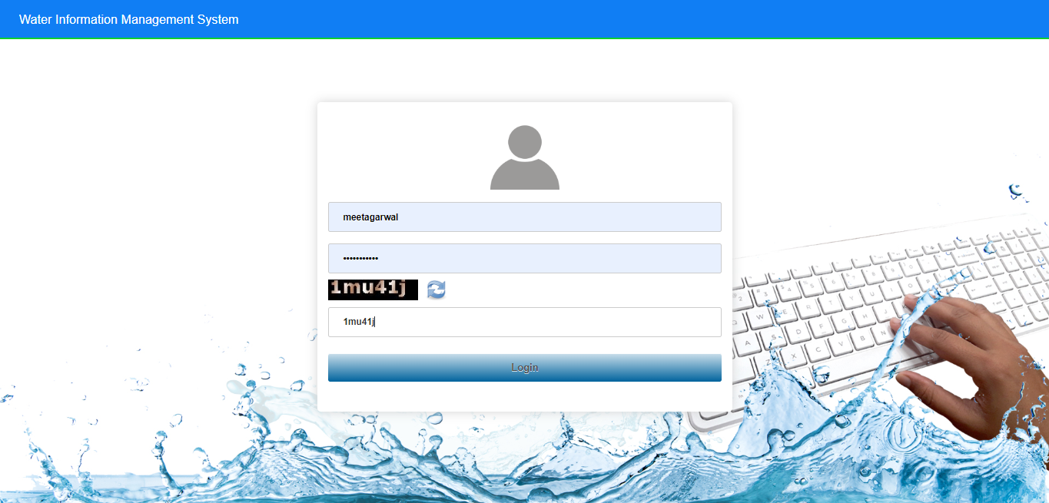
Login into WIMS

Slide 9
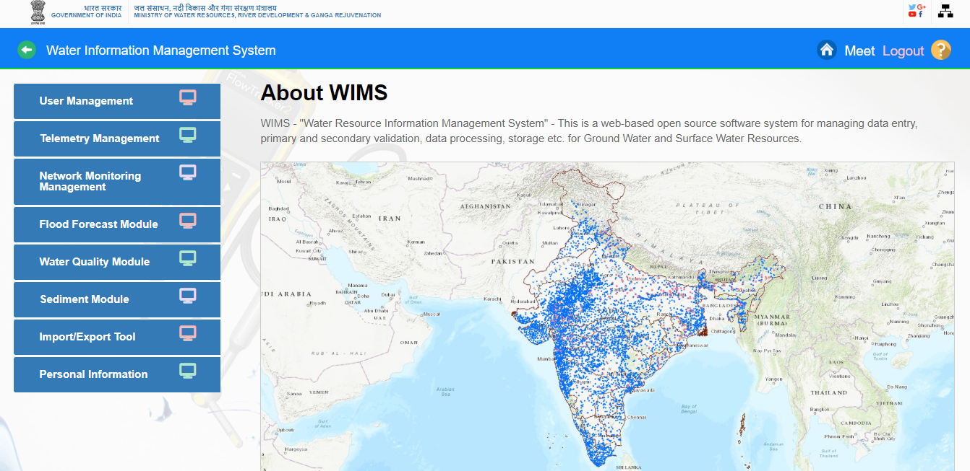
Home page of WIMS will be displayed on screen after login into WIMS application. User once done with the work can logout the session using the Logout Icon on the right top corner. Home Icon is to navigate back to the main page from sub modules page

Slide 10
Manual Data Entry-
Manual Data Entry Module enables users to add observed data for stations (Surface Water or Ground Water ) for selected time duration. 1.Manual Data Entry Module is listed Under Network Monitoring Management 2.Click on Manual Data Entry icon

Slide 11
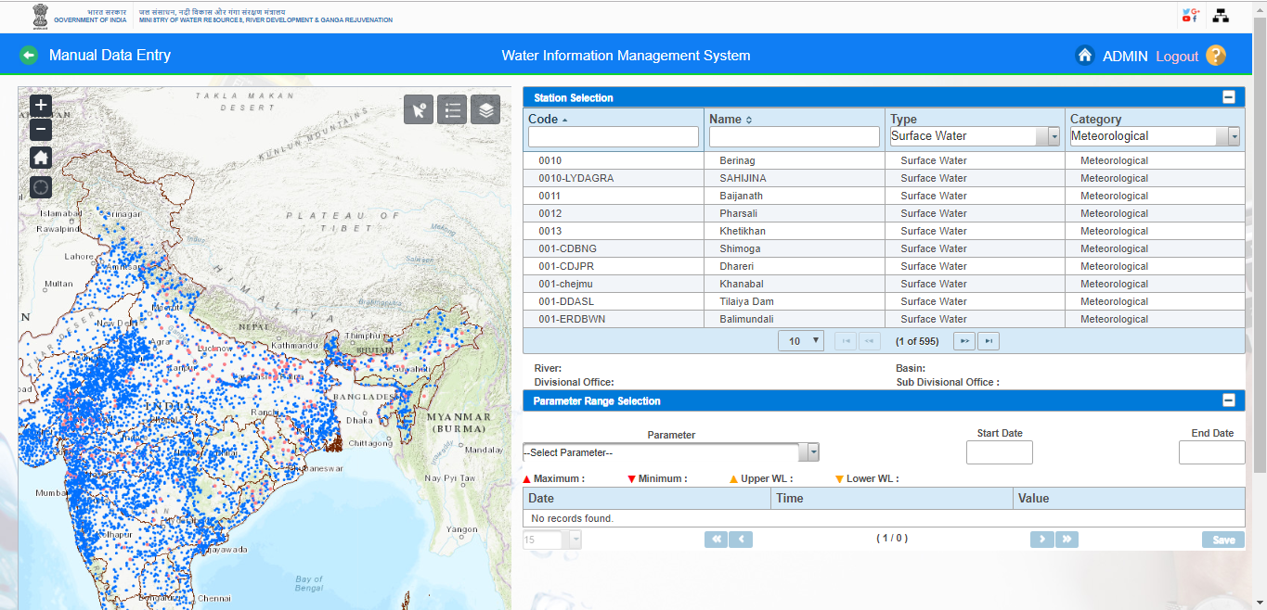
Map showing CWC Basins along with the Data Form is available as shown in Figure

Slide 12
3.User has choice to select based on the provided filters in the form section or use the map section to select the station for which data is to be entered.
4.Select the Station Type using radio button - Surface Water or Ground Water
5. Based on the selection different Category will be populated in the drop down button (for example Category - Hydrological).

Slide 14
6.Based on the Category, user can select by entering letters in the text box provided for Station Code or Station Name. Example, first 3 character of station code “002” and select the station code -0029-LKDHYD from the dropdown list

Slide 15
7.Based on the Station selected, list of Parameter measured on the selected station will be populated in the drop down button. For example, Parameter - MANUAL-WL by Staff Gauge (MSL) (HHS)

Slide 16
8.Once the Station is selected, the duration of the observed data to be entered using the Start Date and End Date. By Default Start Date and End Date is listed but user can also change the start date and end date

Slide 17
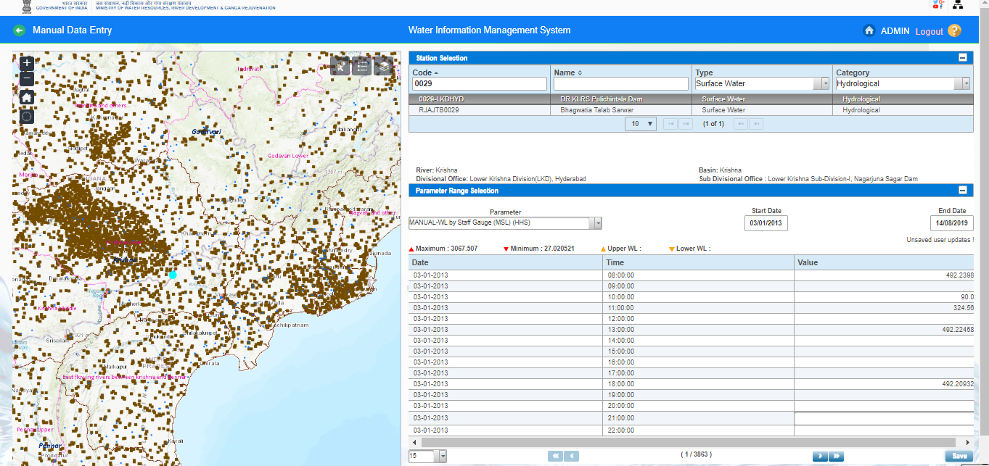
9. The table displays the following Attributes: Minimum , Maximum,Upper WL,Lower WL Date, Time, Value.
10. Enter the Value for the observed Water Level at the Time and click on Save button
11.Paging Navigation is given below of parameter table to navigate between pages of the table.

Slide 18
Data Validation
Primary Validation of data is carried out simultaneously while data is entered in respective data entry forms.
Few more data validation options are available to ensure consistency of data entered by making
comparison of related data that are observed and entered independently.
Data Validation Module enables users to add validated values for data stored in the database and also
filling data gaps for the stations in WIMS under various parameters for Surface water and Ground water
- Click on “ Network Monitoring Management” Tab “ , Data Validation icon is displayed on screen

Slide 19
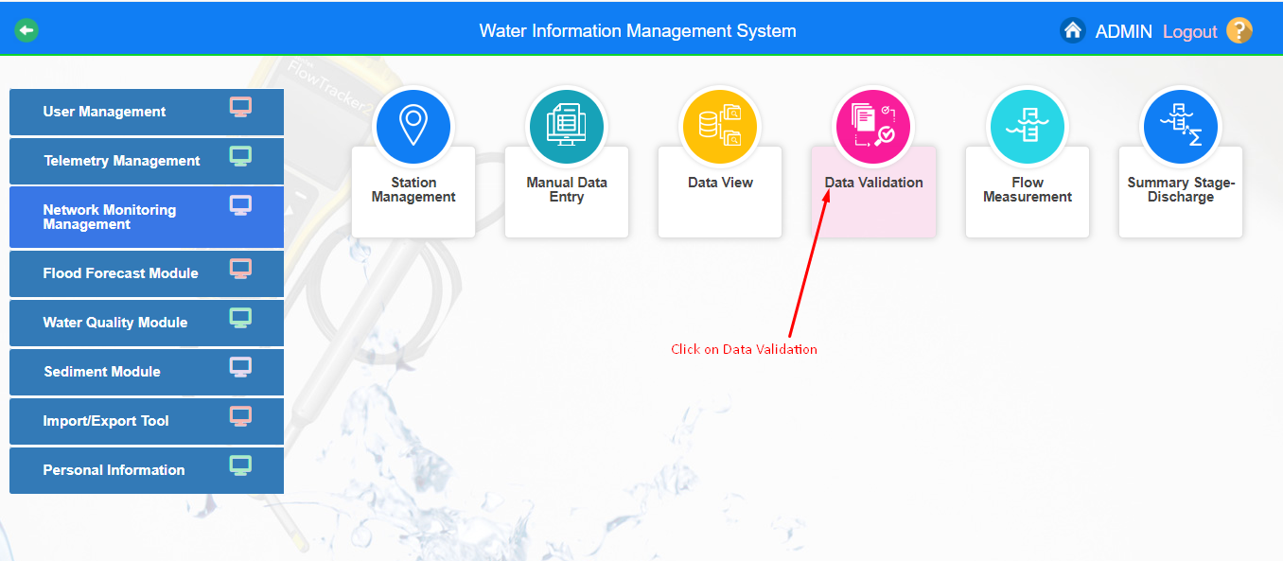
Data Validation
.

Slide 20
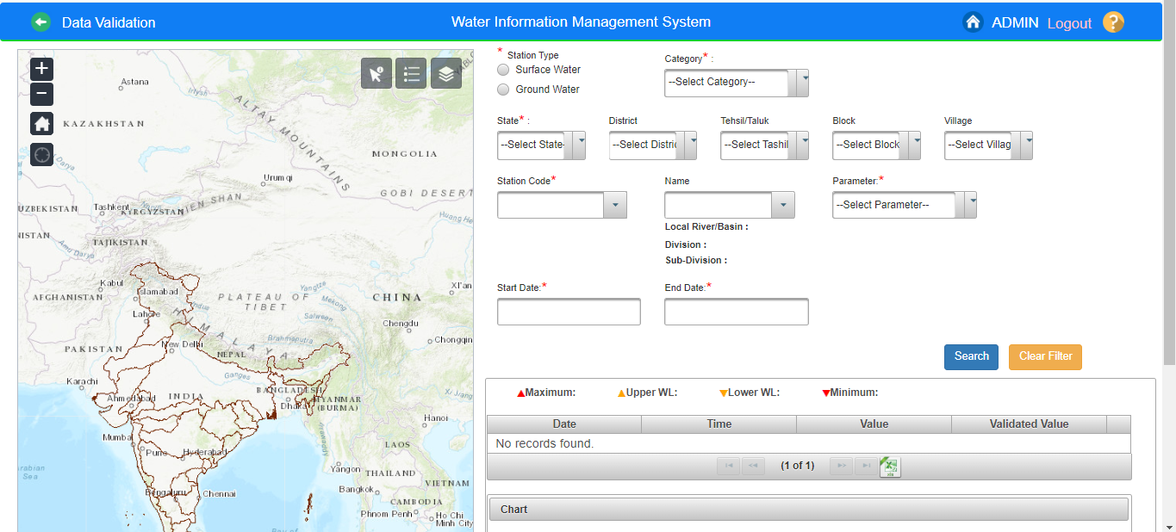
Data Validation .
1. Click on Data Validation button .By clicking “Data Validation” following screen/page will appear.

Slide 21
Data Validation
2.User has choice to select based on the provided filters in the form section or use the map section to select the station for which data is to be validated.
3. Select the Station Type using radio button – Surface Water
4. Based on the selection different Category will be populated in the drop down button after that user can search the station code or name for the selected category

Slide 22
Data Validation

Slide 23
Select or fill all respective mandatory fields
Data Validation
5. Select the State from dropdown
6. Based on the Category, user can select by entering at least 3 letters in the text box provided for Station Code or Station Name. Example, first 3 character of station code “002” and select the station code - 029-mgd5ptn from the dropdown list
7. Based on the Station selected, Station Name will automatically be populated for the selected station code and application navigates the selected station name on map.

Slide 24
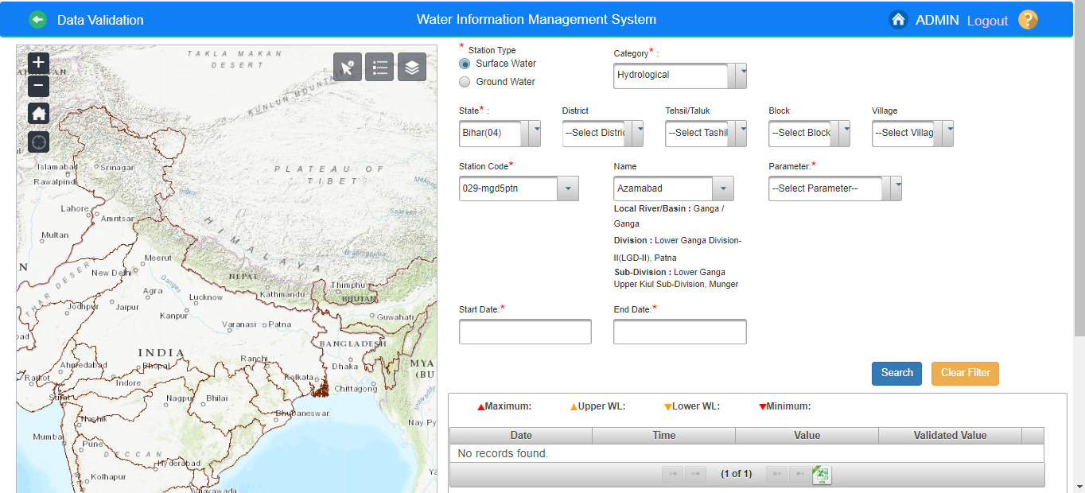
Data Validation

Slide 25
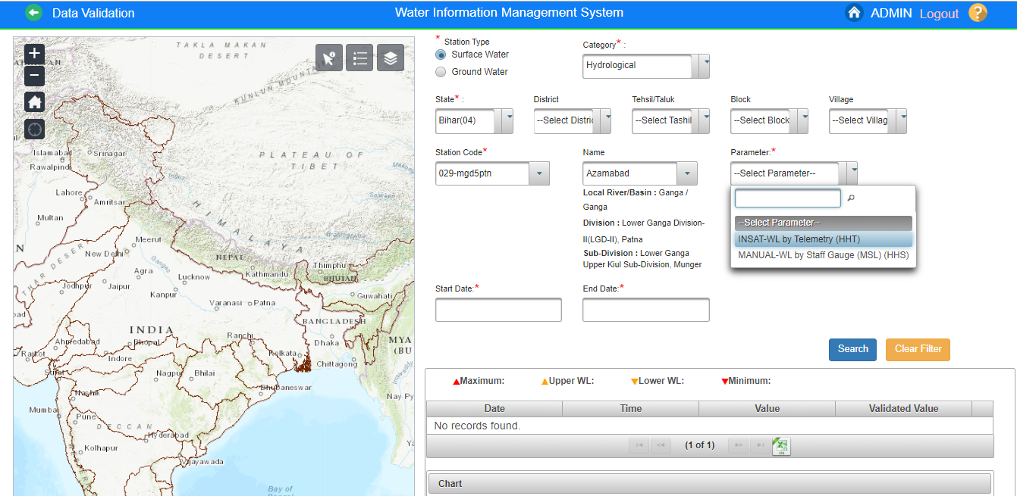
8.List of Parameter measured on the selected station will be populated in the drop down button.

Slide 26
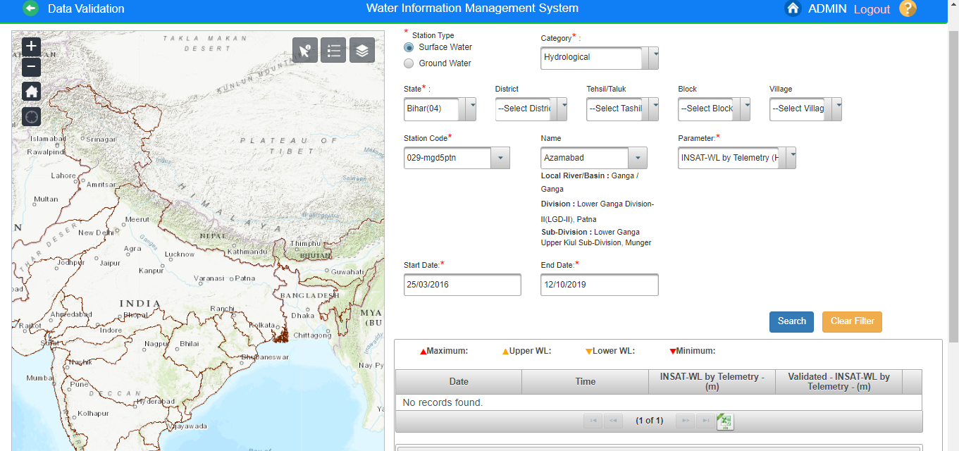
9.Once the Station is selected, the duration for which data is present for the parameter selected of the station will be automatically filled in the Start Date and End Date panel.

Slide 27
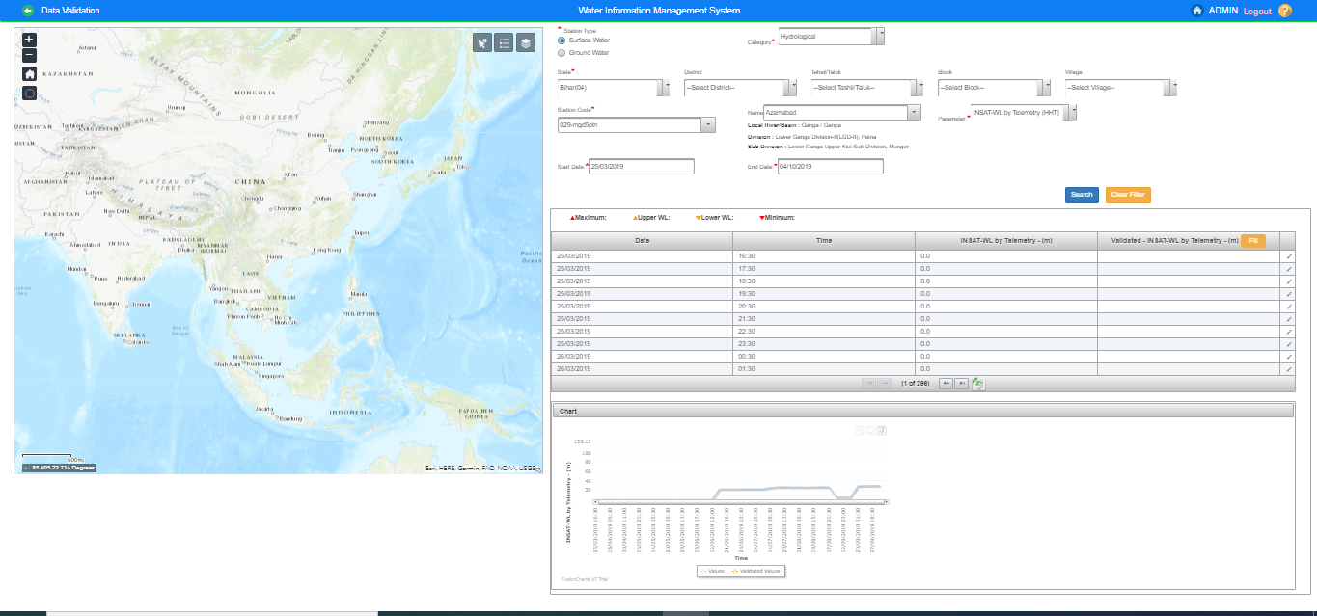
10.Click on Search button. The table displays the following : Maximum, Minimum, Upper WL, Lower WL Attributes: Date, Time, Parameter with units, Validate Parameter with units

Slide 28
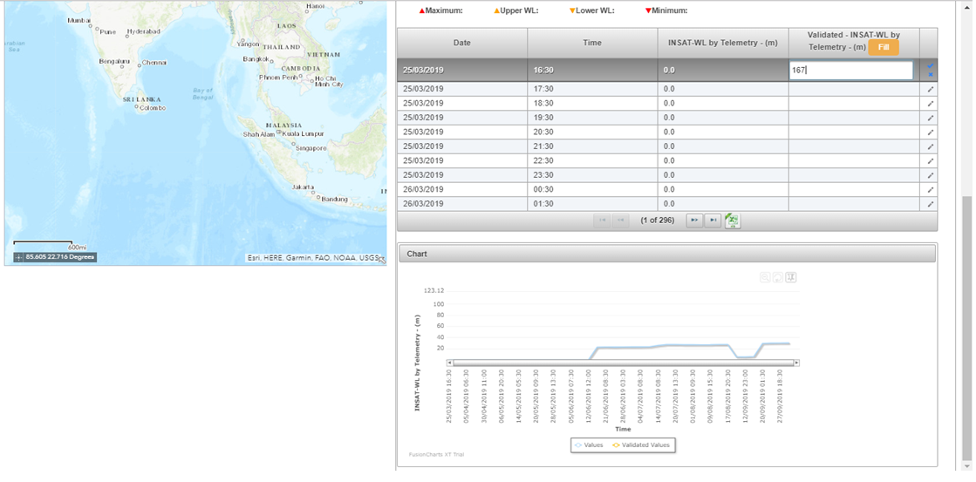
11.Data In Charge can validate and edit the data . Use Edit Icon to add the validated value for the required Row. In case user wants to put the data in the database in bulk to be copied to validated database then use the Fill Icon.

Slide 29
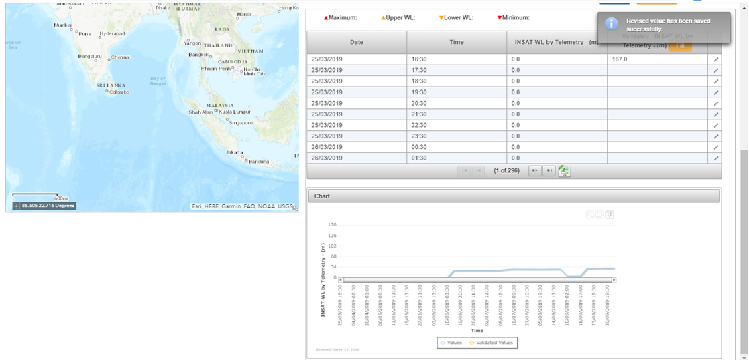
12.Click on Save icon . Validated Value is saved and Popup a message “Revised Value has been saved successfully” is displayed on screen. Paging Navigation is given below table to navigate between pages of the table

Slide 30
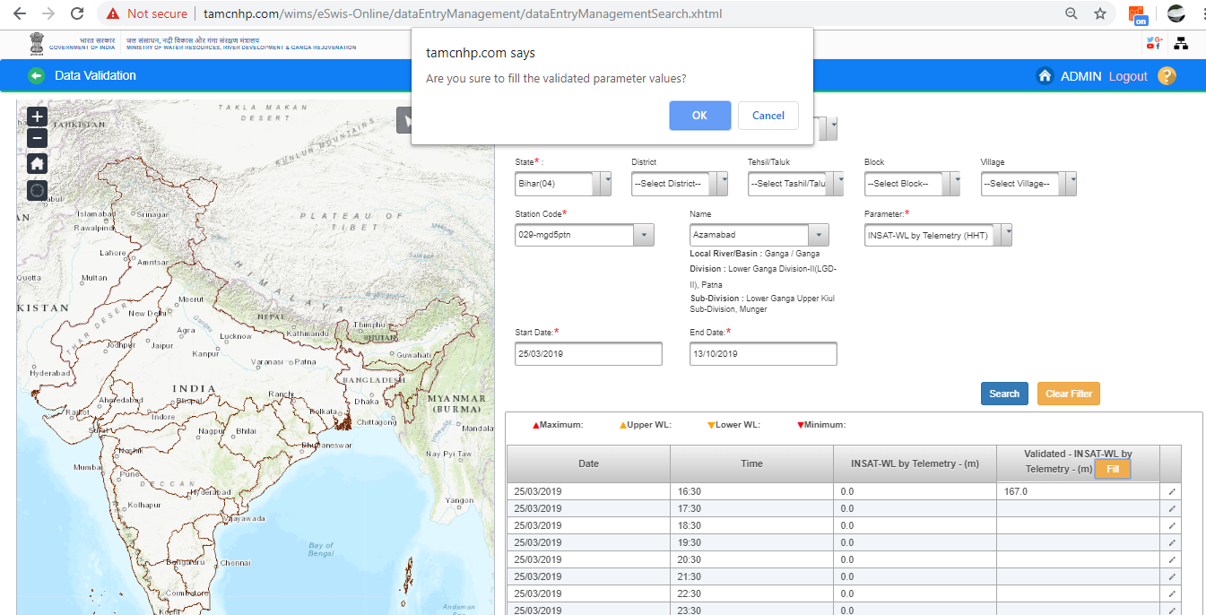
Click on “Fill” button to validate the parameter values. Click “ OK” button to validate or Click “Cancel” button to cancel it

Slide 31
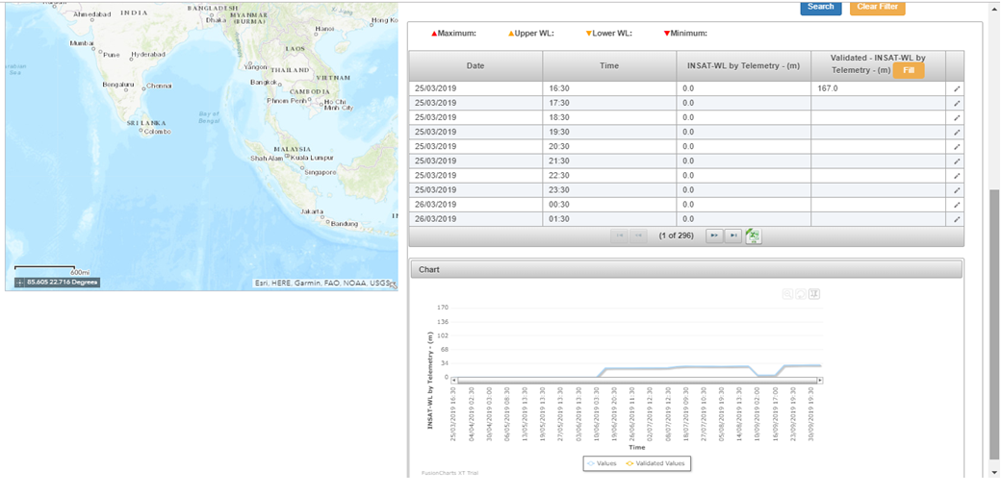
13.Data is validated and validated value is display under validated column. Under the Chart section, graphical representation of the observed and validates data can be seen

Slide 32
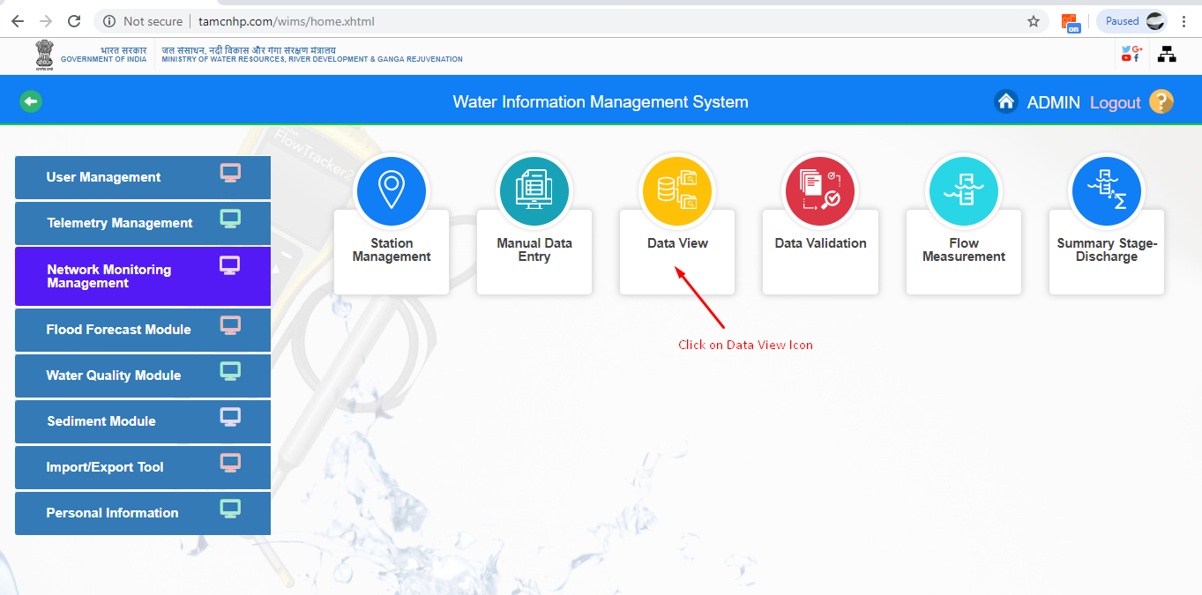
NETWORK MONITORING MANAGEMENT
Data View
Nodal Agencies can view their data either of Surface Water , Ground Water and telemetric stations on basis of Parameter type under Data View Section in WIMS. "Data View" tool is very useful to verify available data in the database. There is the way to check the data "By Parameter Type"

Slide 33
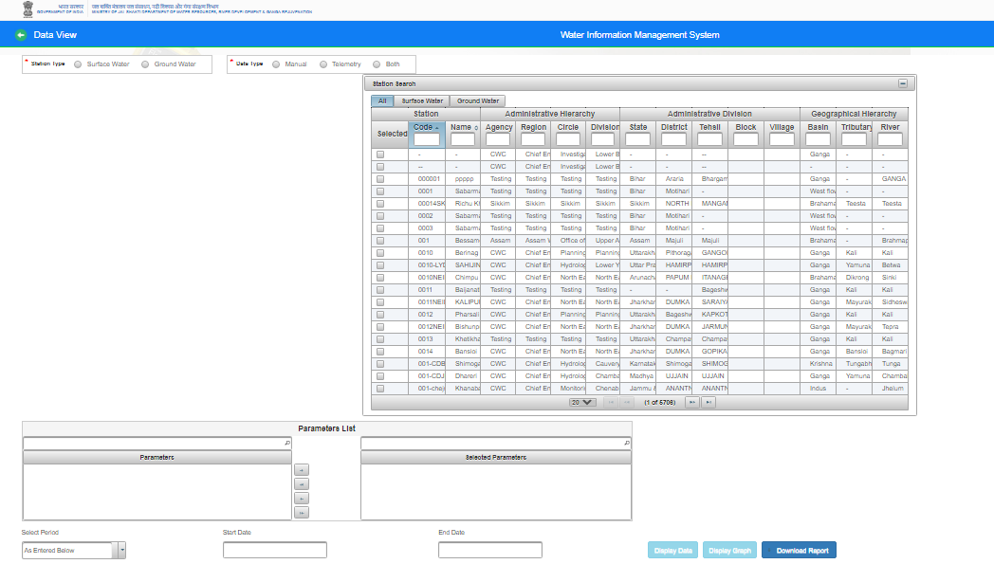
Data View : - Click on “Data View” icon . Data View page is open on the screen

Slide 34
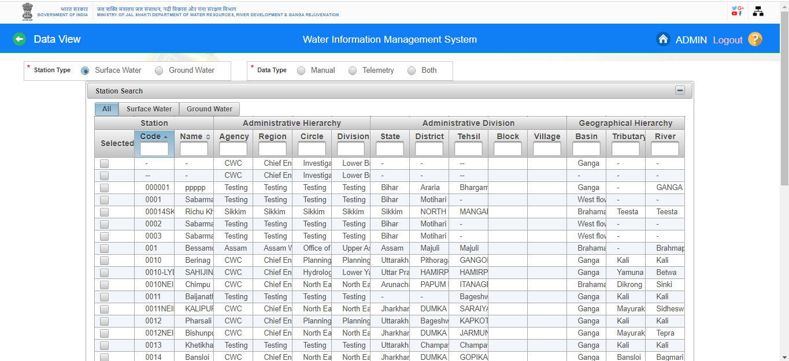
- Station Type :Select Station Type (Surface Water ) Radio Button

Slide 35
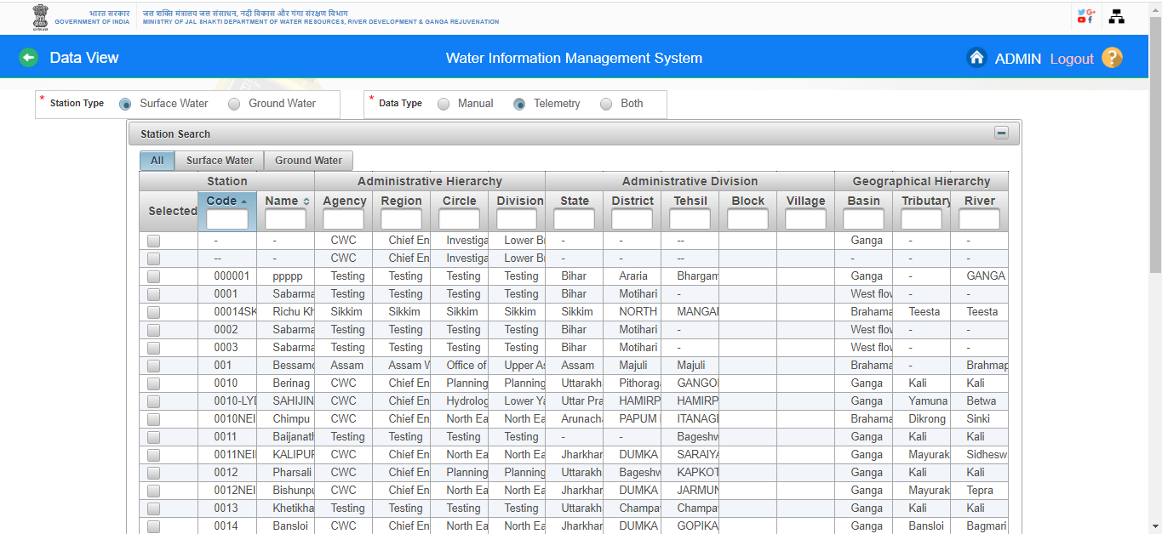
-Type : Select Type( Manual , Telemetry Station or Both)

Slide 36
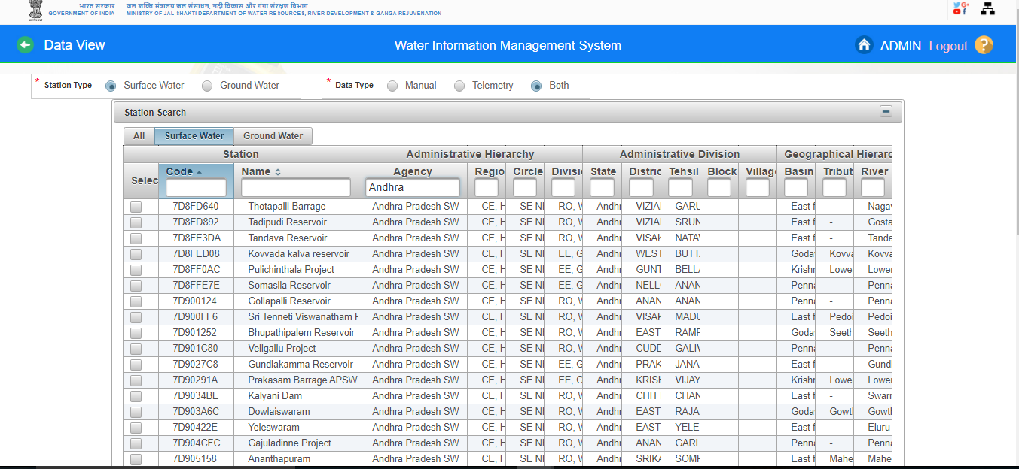
Station Search in Data View : Select any criteria for searching the station under advanced search on basis of Major basin , state or agency etc. for Surface Water Sites

Slide 37
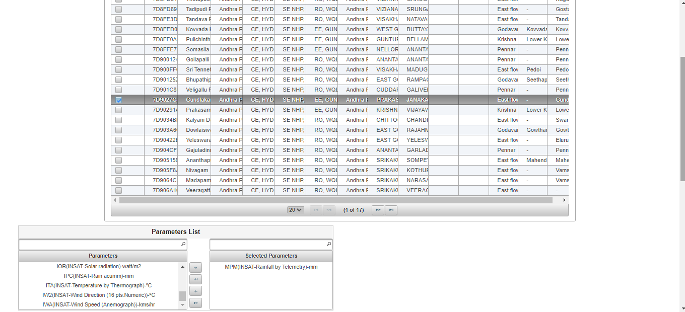
Select station from station search panel

Slide 38
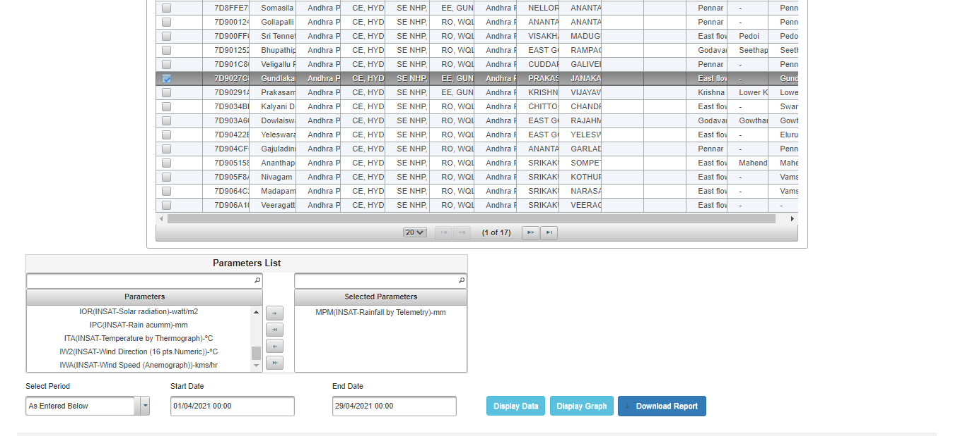
Drag parameters. User can either select criteria maximum 2 stations & 4 parameters for Display Data and Graph or Select multiple station and one parameter also

Slide 39
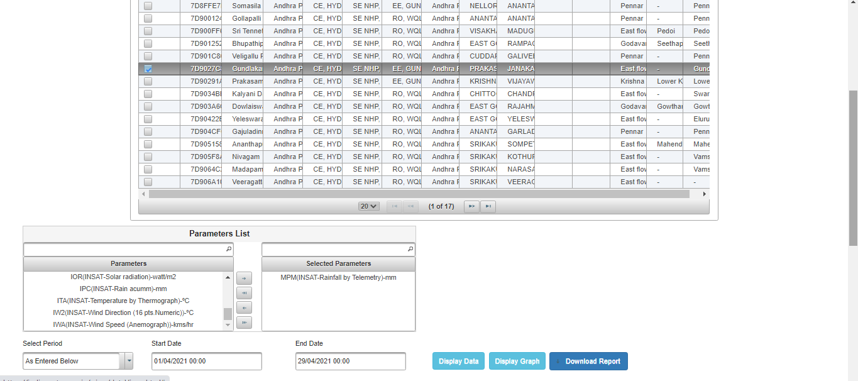
Click on Select Period and select any period for Surface Water Sites

Slide 40
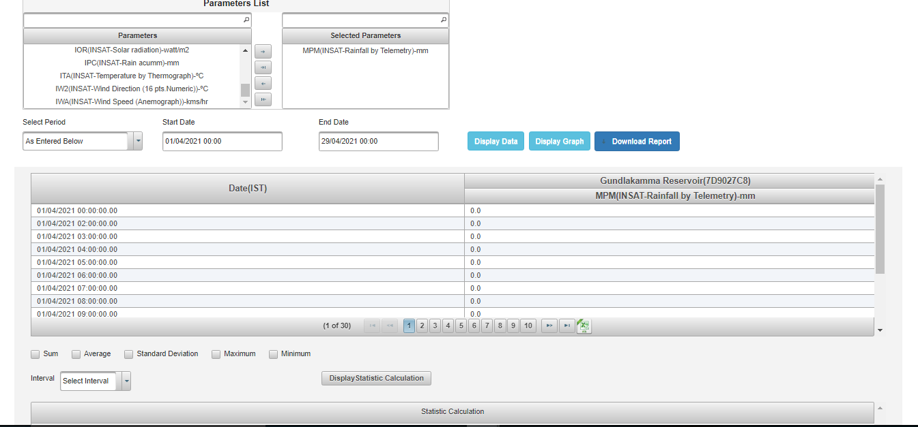
Display Data :Click “Display Data” Button. All the data of station with parameter’s wise listed in table form

Slide 41
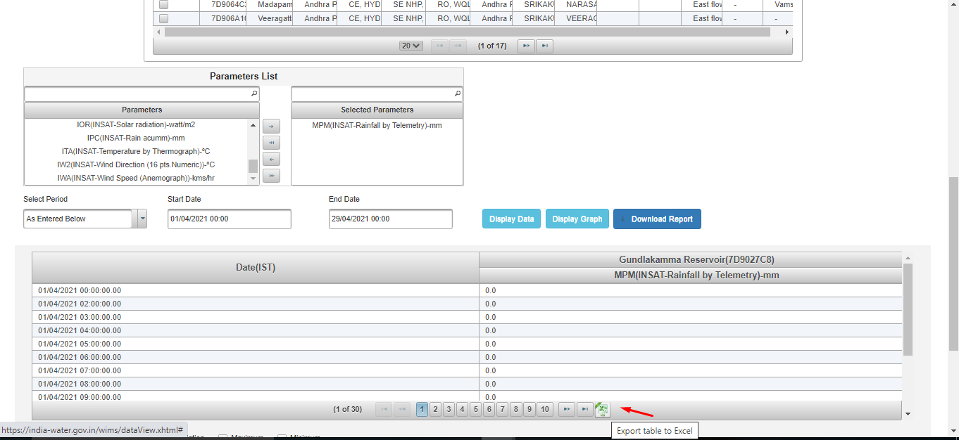
Click on ”Export table to Excel “ for download the data

Slide 42
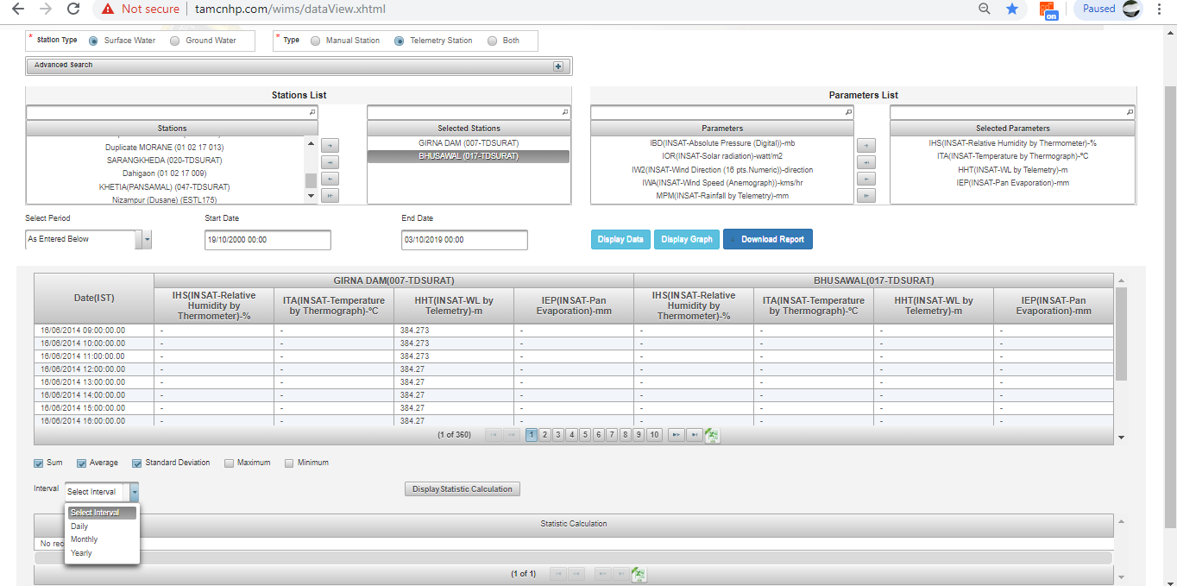
Select any check box (Sum, Average, Standard Deviation, Maximum & Minimum) and Interval ( Daily, Monthly, Yearly) from the dropdown

Slide 43
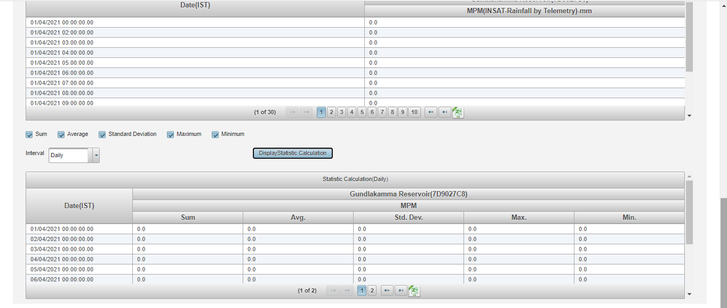
Select checkboxes for Example Sum, average etc.. and Select any interval (Daily Weekly or Hourly and Select the period from dropdown

Slide 44
Click on “Display Statistic Calculation”. Statistic Calculation will be listed in tabular form and click on Excel icon to export the data in excel format

Slide 45
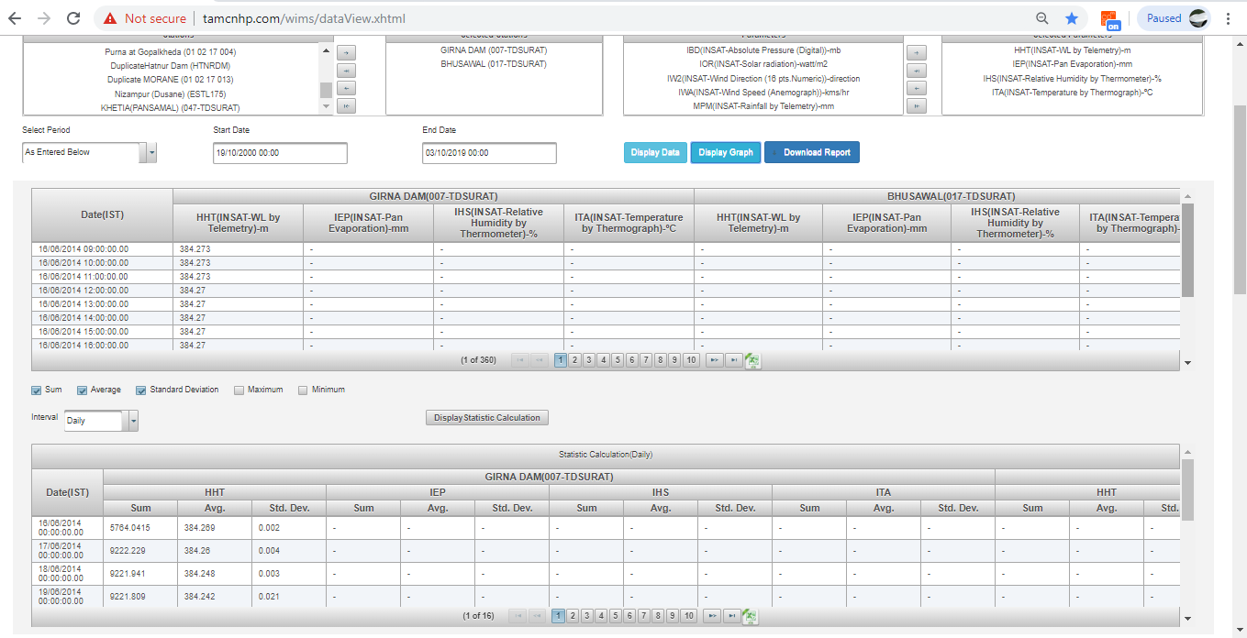
Display Graph: Click on “Display Graph” button for viewing the data in graphical form.

Slide 46
Display Graph: Click on “Display Graph” button . Under Charts section, Graphs will be generated with respect to data displaying in table

Slide 47
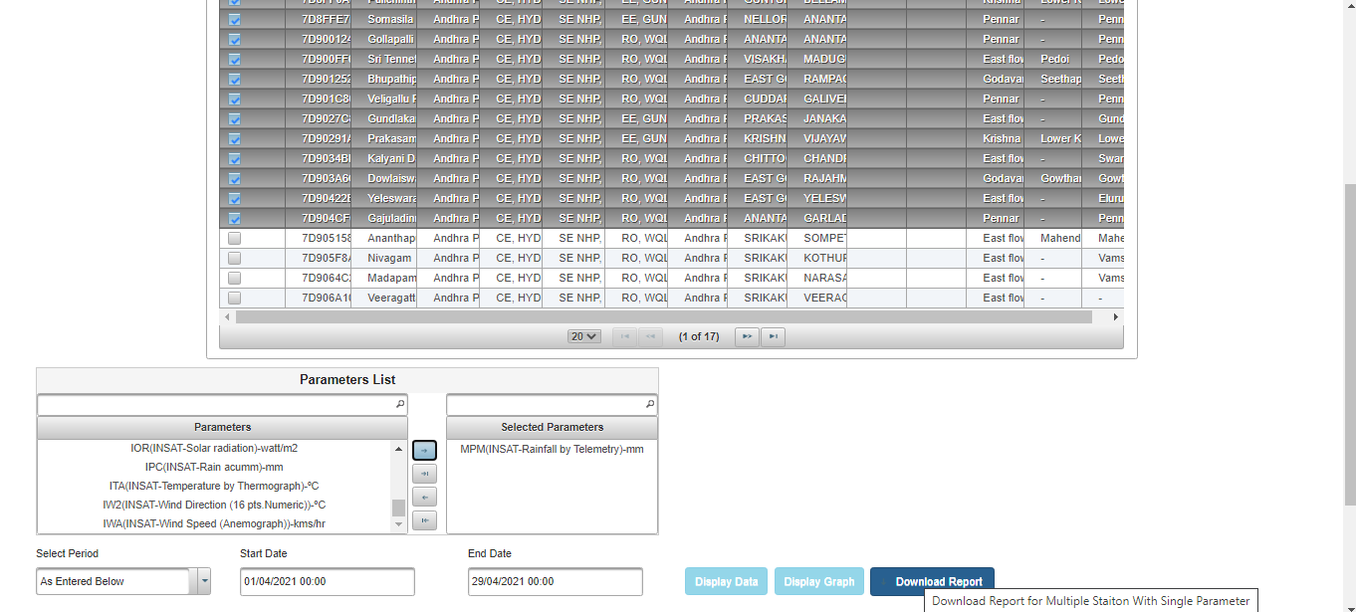
Download Report for Multiple Stations with single parameter for Surface Water: User can view , generate & download the report of multiple stations and one parameter in data view module

Slide 48
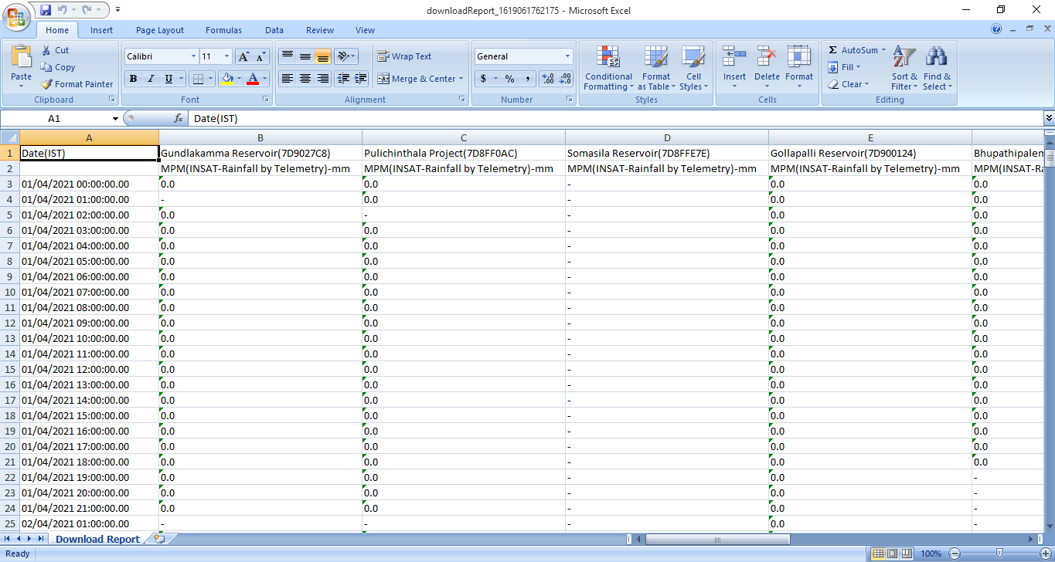
Click on Download Report Button for multiple stations. Report will be download in excel format and user can view the data if it is present

Slide 49
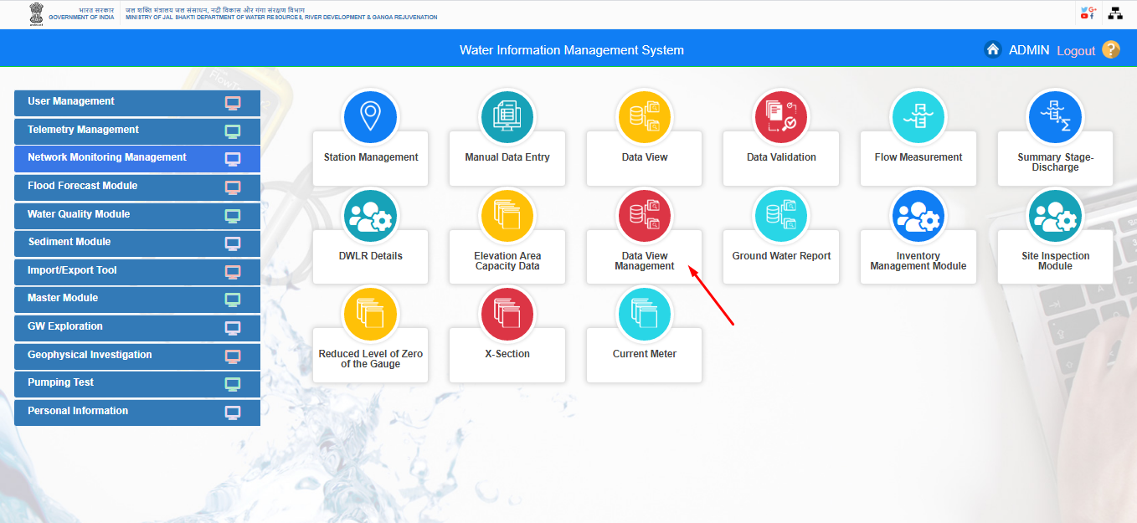
Data View Management

Slide 50
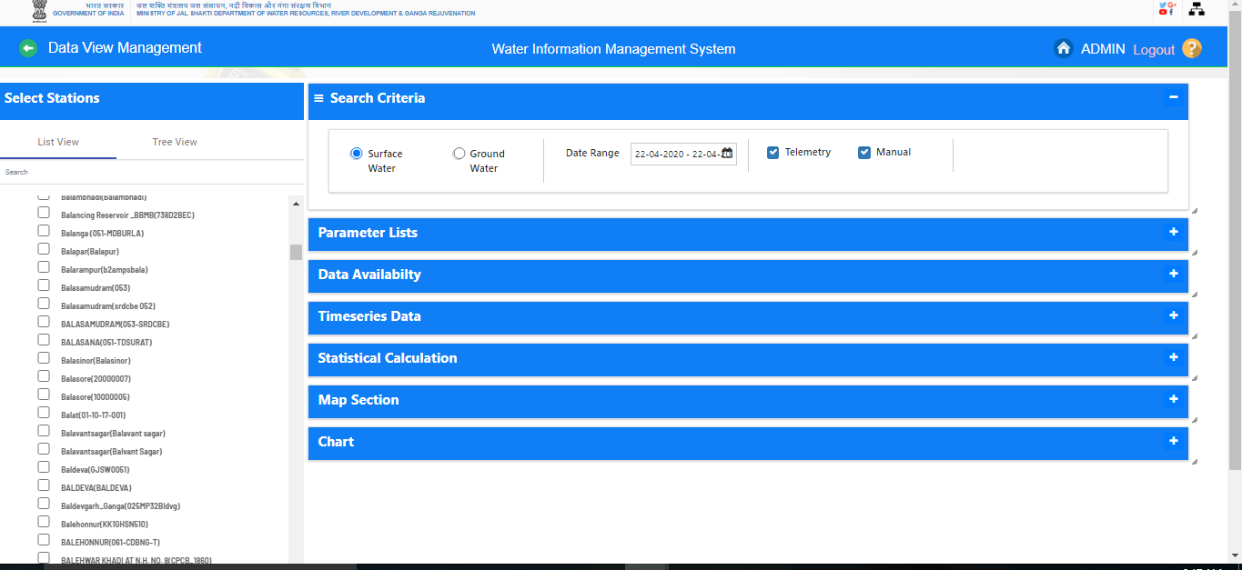
Data View Management

Slide 51
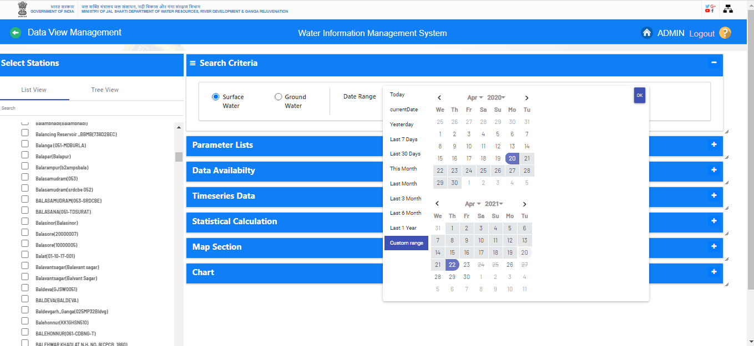
Data view Management

Slide 52
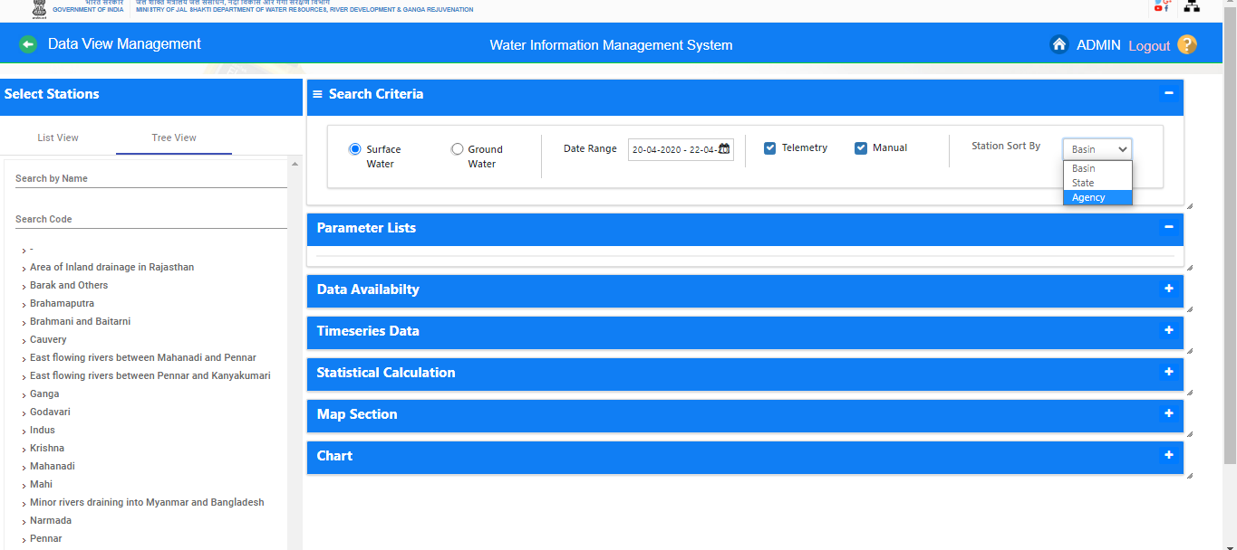
Data View Management

Slide 53
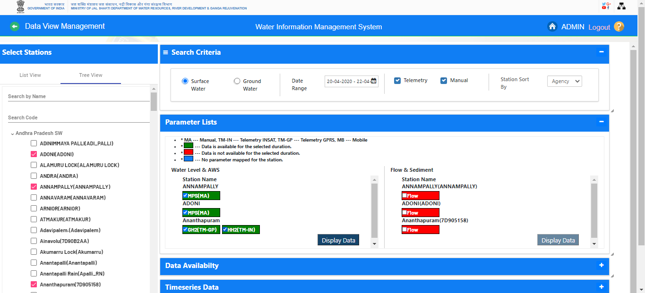
Parameter Listing

Slide 54
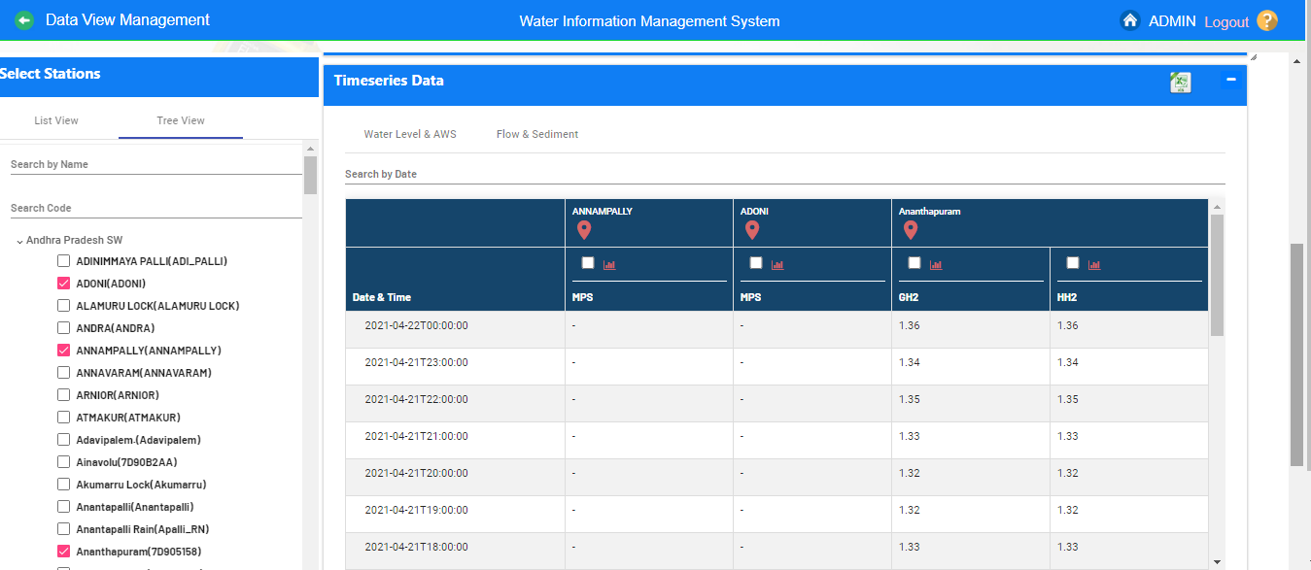
Display Time series data

Slide 55
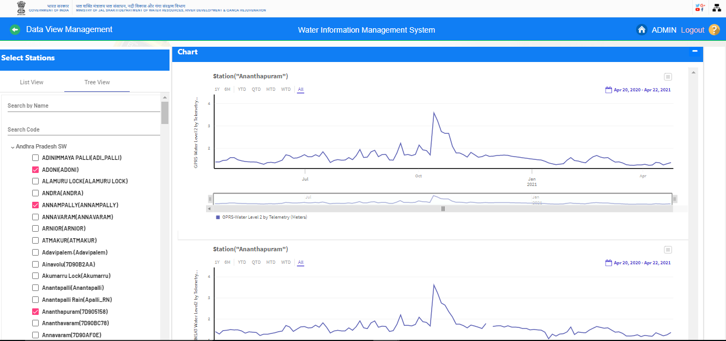
Charts

Slide 56
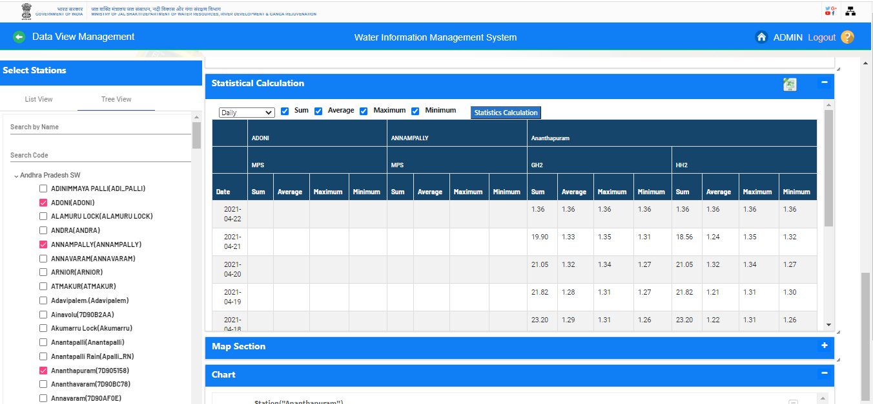
Statistical Calculation

Slide 57
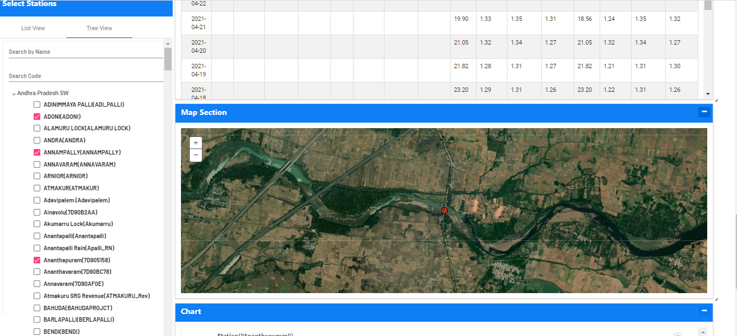
Map Section

Slide 58
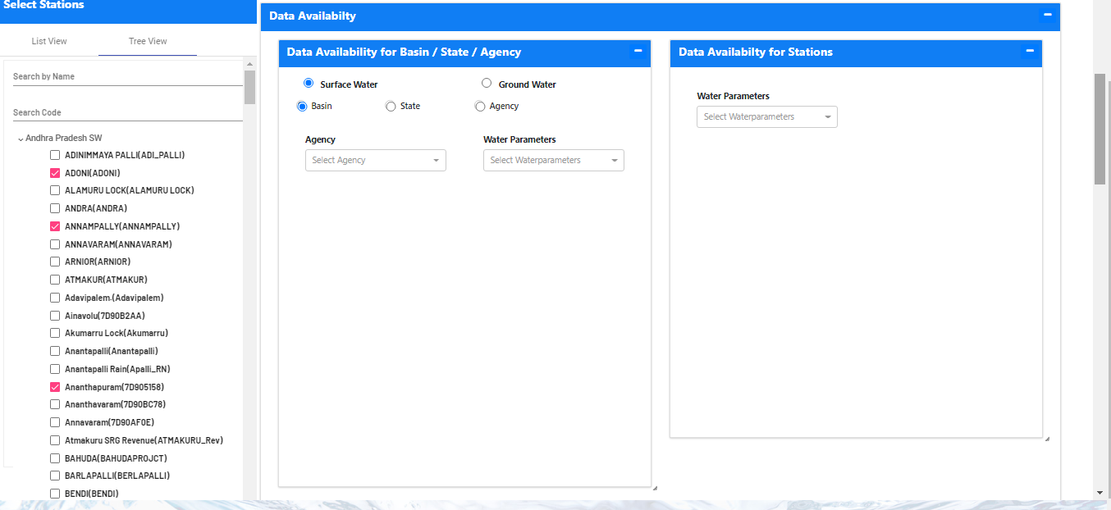
Data Availability

Slide 59
Questions and Answers with Feedback
For any query & help, you can send email on helpdesk-nwic@gov.in

Slide 60
THANK YOU

